Slide 1
Data Visualization and Data Analyst – Internship
Course: Task 4: Store Forecasting Sales and Data Analysis
Tool: Tableau
Name: Sakshi Agrawal
Date: 17th Feb, 2026

Slide 2
Business Objective
Objective of Dashboard
Monitor Sales & Profit performance over time
Identify loss-making periods
Analyze category & regional performance
Understand discount impact on profitability
Support data-driven business decisions

Slide 3
Dataset Overview
Dataset Summary
Total Records: 2132
Time Period: 2013–2017
Key Fields:
Sales
Profit
Discount
Category / Sub-Category
Region / State
Order Date

Slide 4
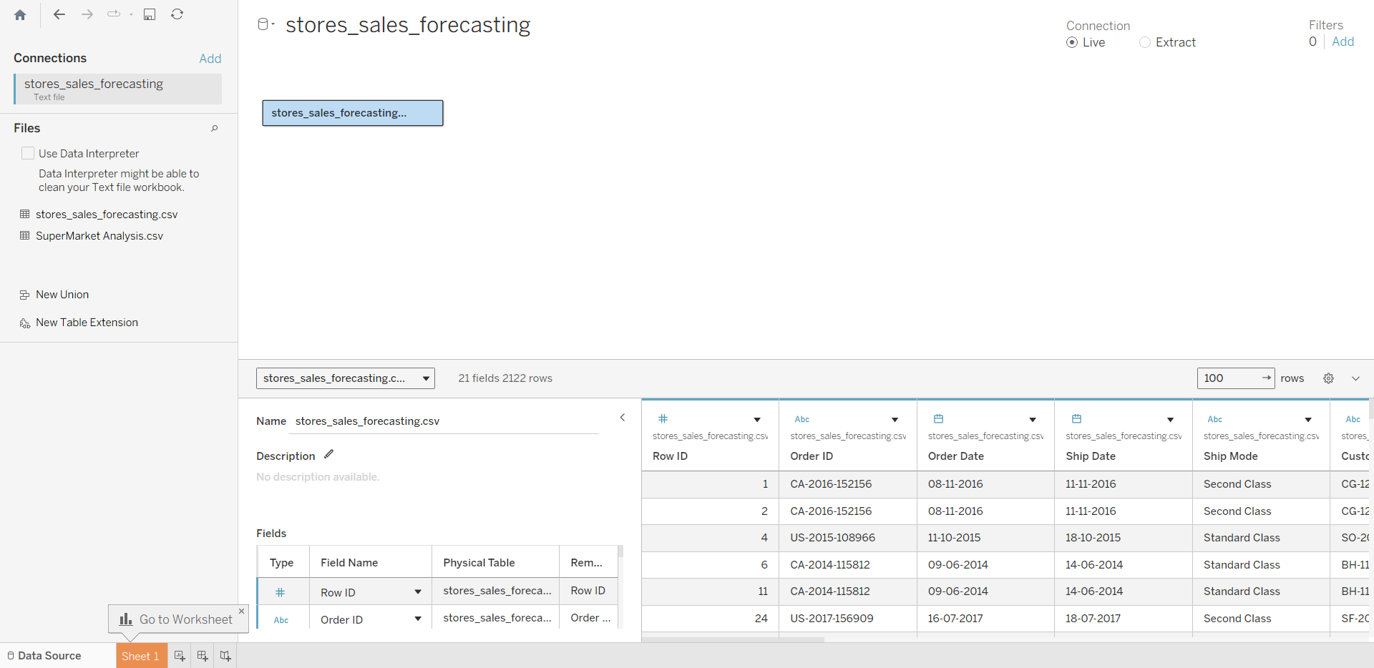
KPI Card Dashboards

Slide 5
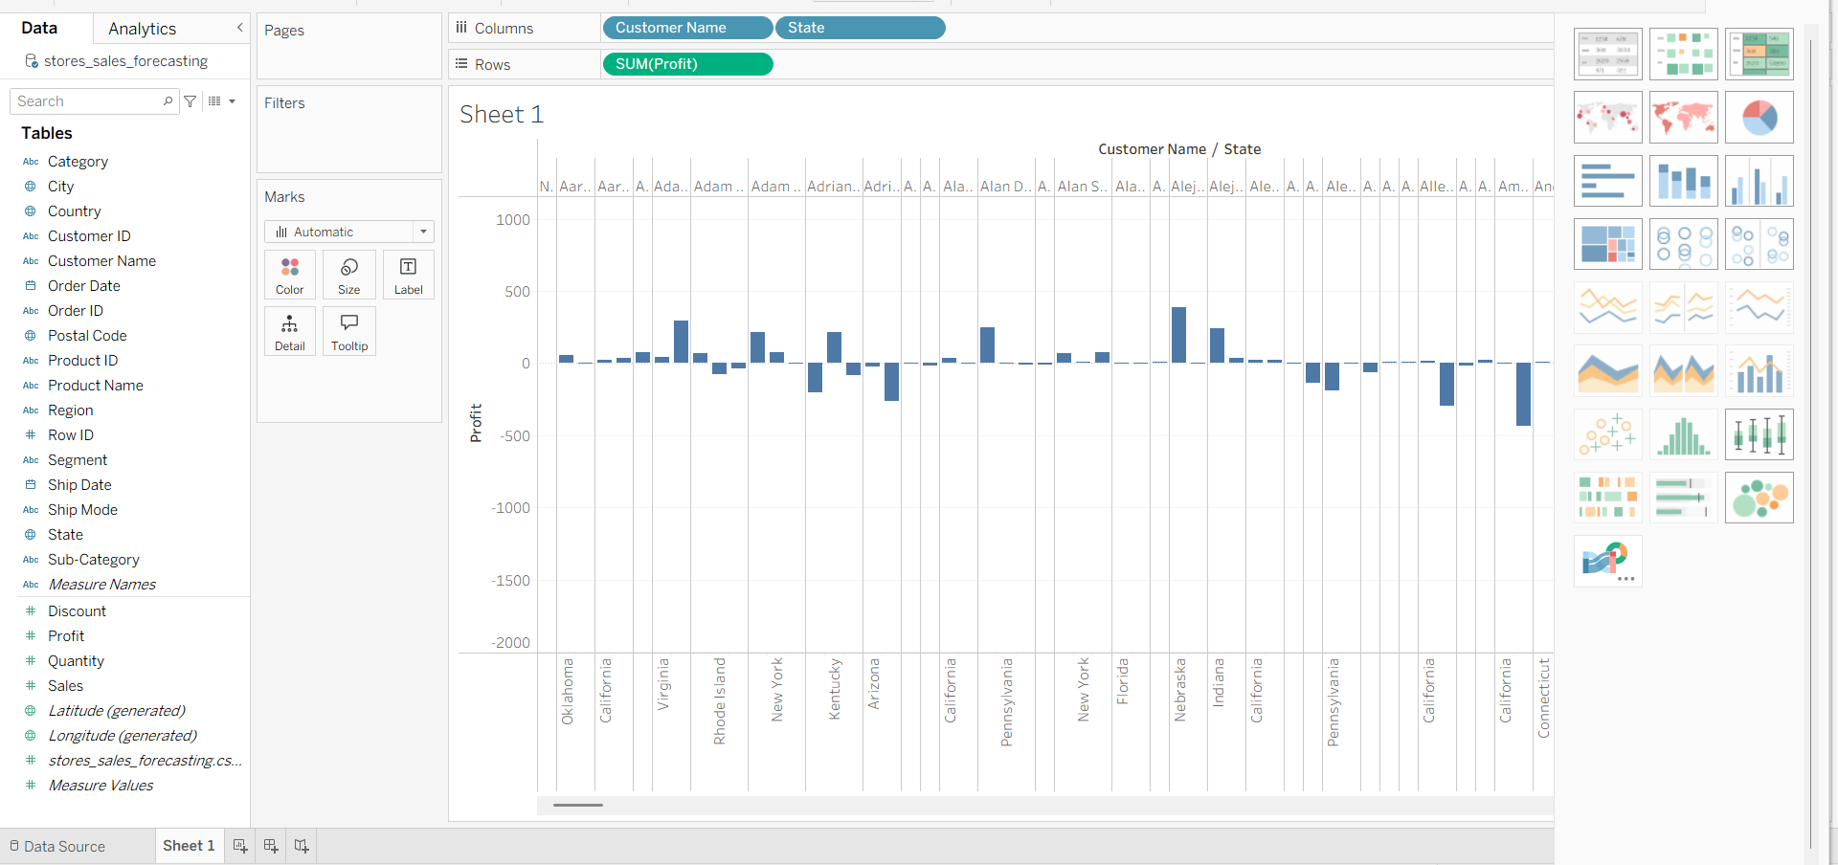
KPI Card Dashboards – Total Profit

Slide 6
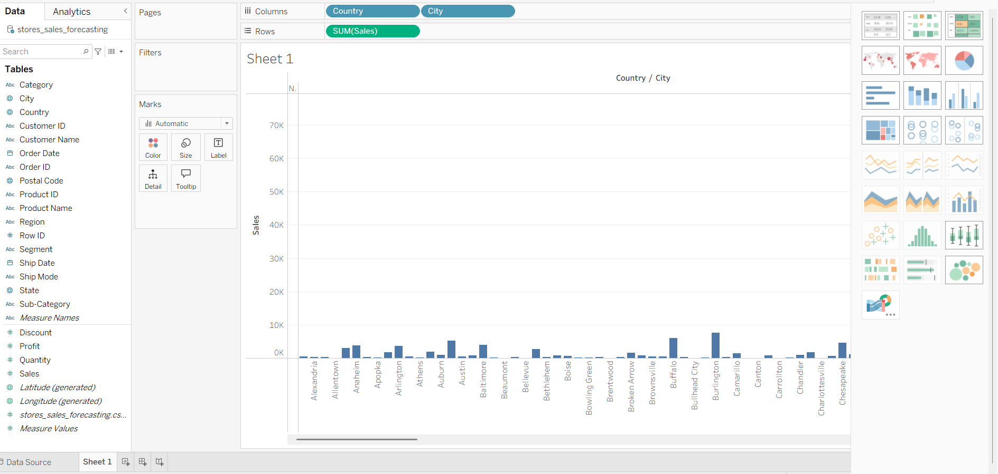
KPI Card Dashboards – Total Sales

Slide 7
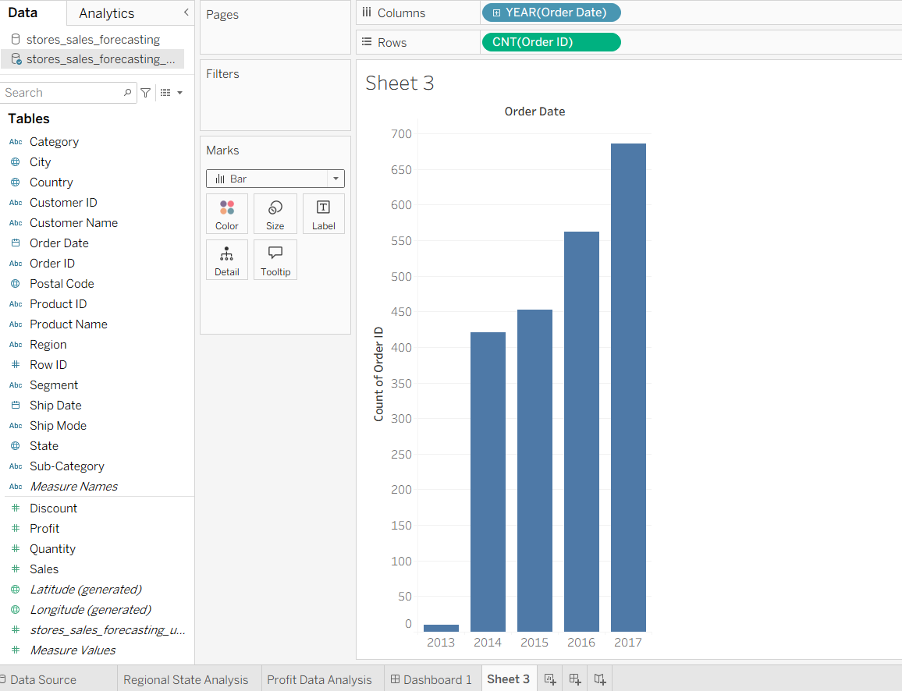
KPI Card Dashboards – Total Orders

Slide 8
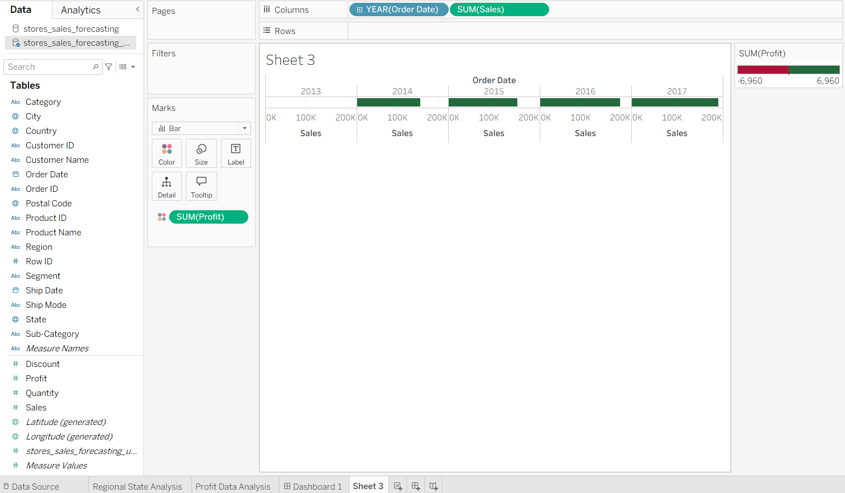
Time-Series Analysis (Sales & Profit Trend)

Slide 9
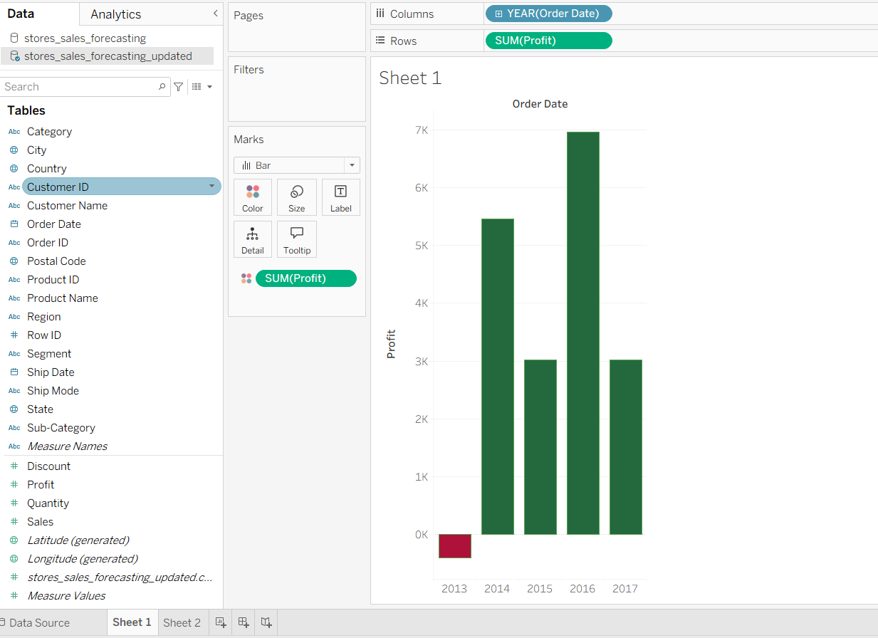
Profit vs Loss Analysis

Slide 10
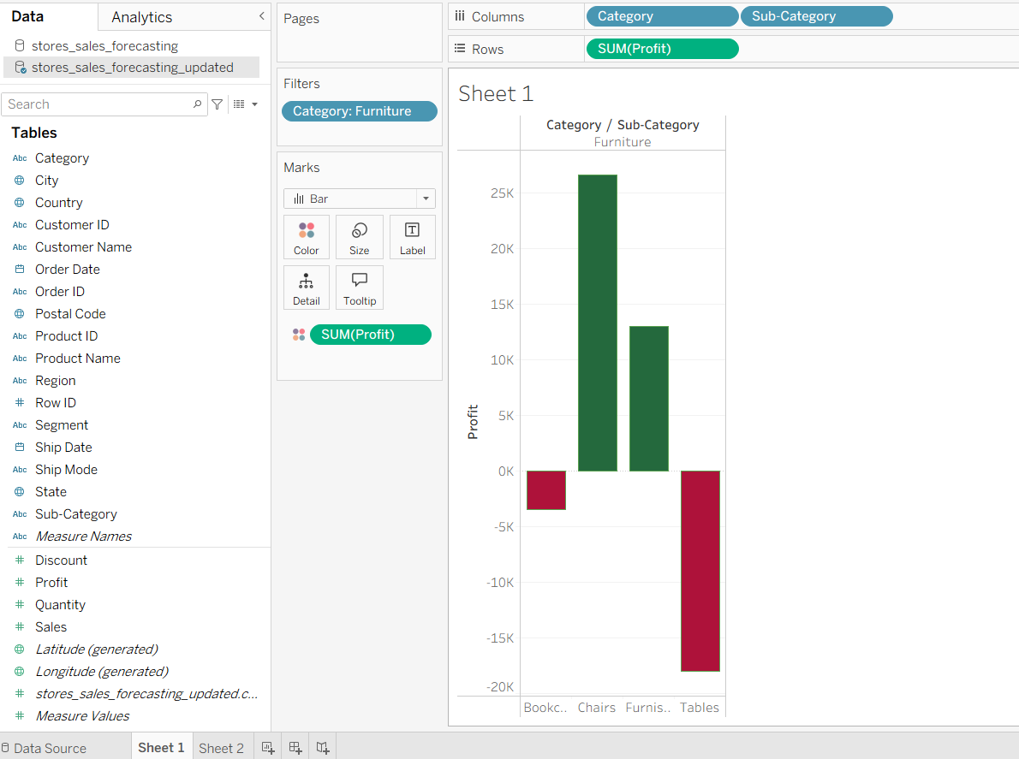
Category Performance

Slide 11
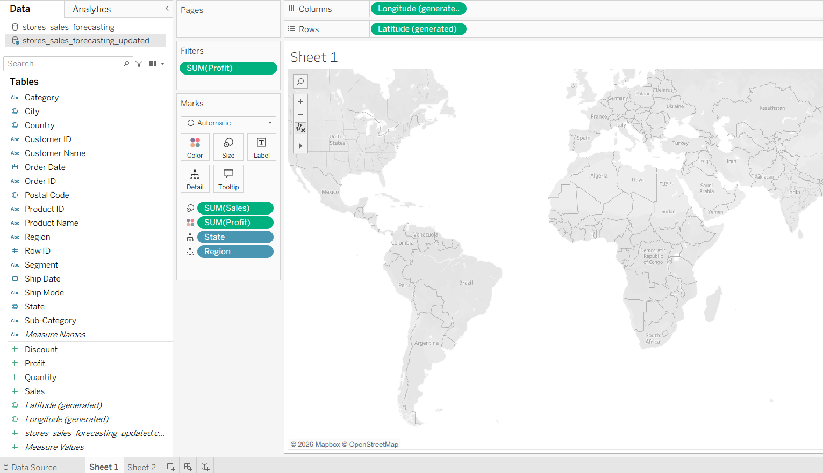
Regional Performance

Slide 12
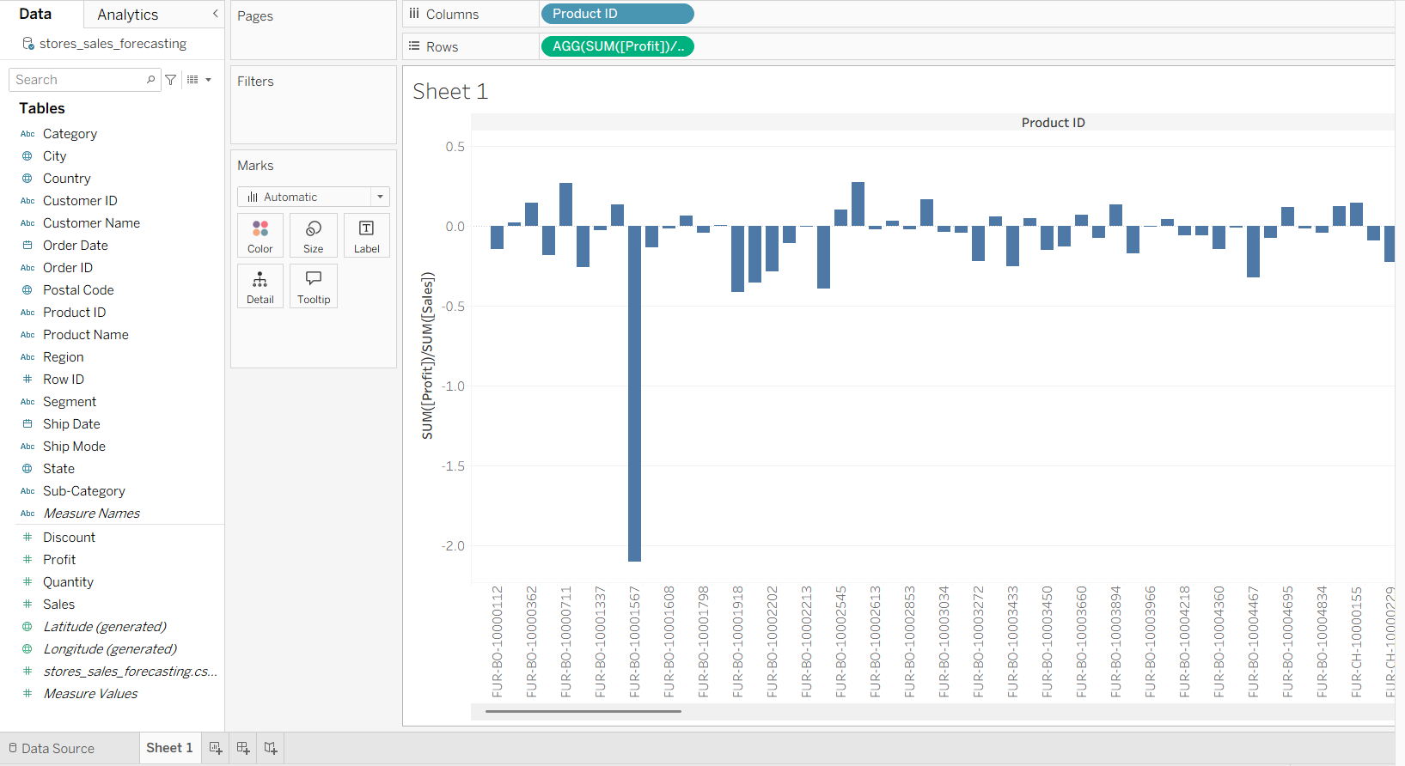
Discount Impact Analysis

Slide 13
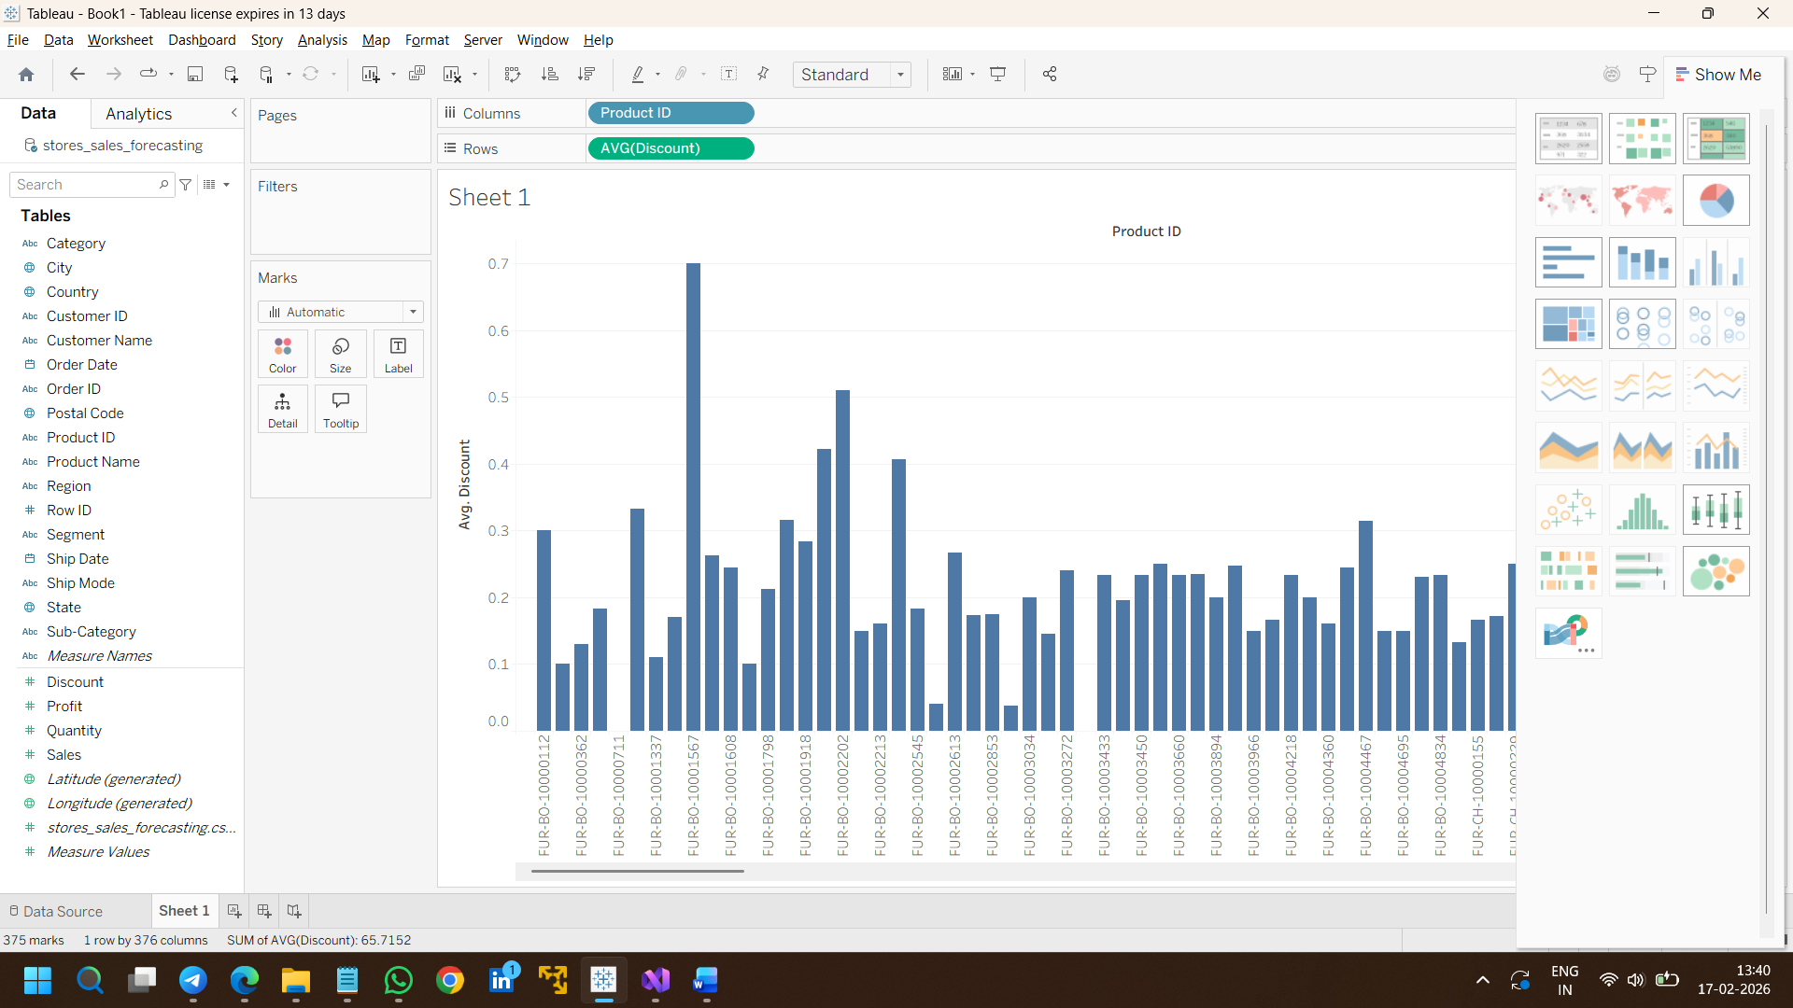
Discount Impact Analysis

Slide 14
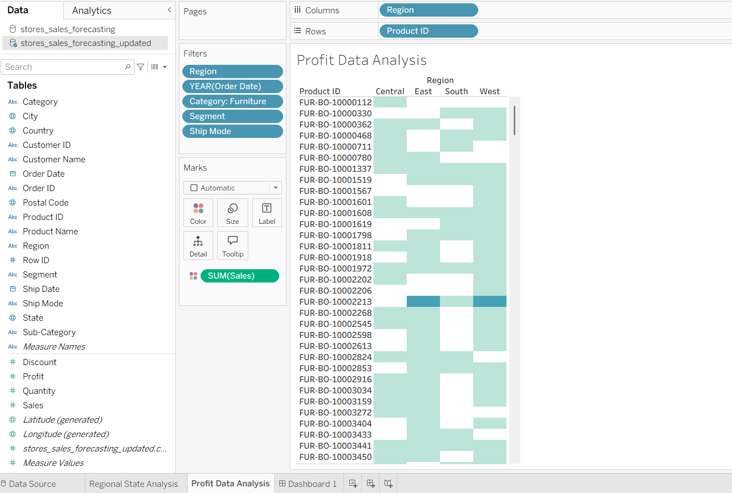
Dashboard Interactivity

